Slide 1
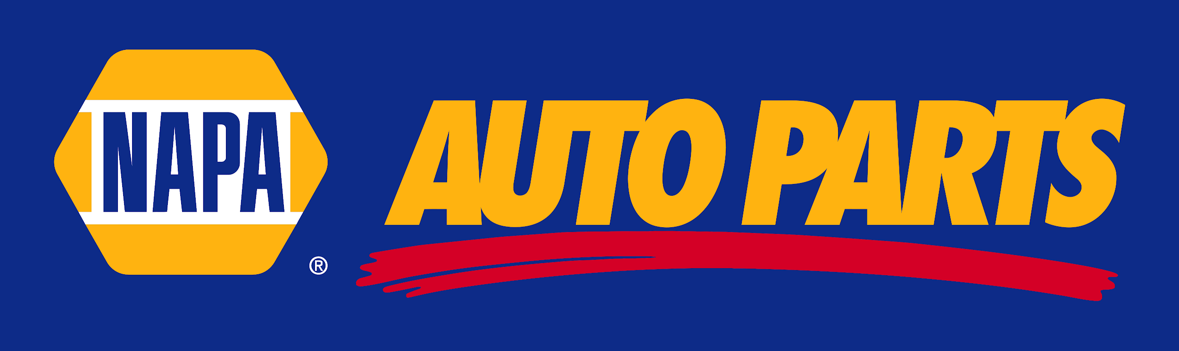
OD Consultation for
Napa Auto Parts, Inc.
Bryan Castillo, et al.

Slide 2
Background
The National Automotive Parts Association (NAPA) has been a key provider of automotive parts and services to people all over the United States since the early 1900s.
Having been deemed an essential business during the pandemic, they have implemented new ways to provide service to their customers in a safe manner for both the client and the worker.
Offering curbside pickup at participating locations
Implementing increased cleaning protocols
Creating barriers where possible to allow for social distancing
Limiting number of customers in store at any given time
Eliminating the need for invoice signatures

Slide 3
Background (Cont’n)
Some key competitors of this particular location include:
Autozone
O’Reilly Auto Parts (2 locations in Vallejo)
Monument Car Parts
Burt Williams and Sons, Inc. (Walking distance from Napa Auto Parts)
Focuses on truck parts more than consumer auto parts
In early April, this location underwent ownership transfer from being a Private Franchise, to a Corporate Owned location

Slide 4
Organization Description
Located in Vallejo, CA
Store opened in 2000 as privately owned franchise, now corporate owned
Business Model: Selling Auto and Truck Parts to consumers through their retail store, delivering to local mechanic shops or truck garages, and shipping through online catalog
Has a 4.5/5 star rating on Yelp
According to managers, store has been experiencing significant growth in finances, with revenue increasing by 71% from Fiscal Year 2018 to 2019, projecting higher increases in the next 5 years.

Slide 5
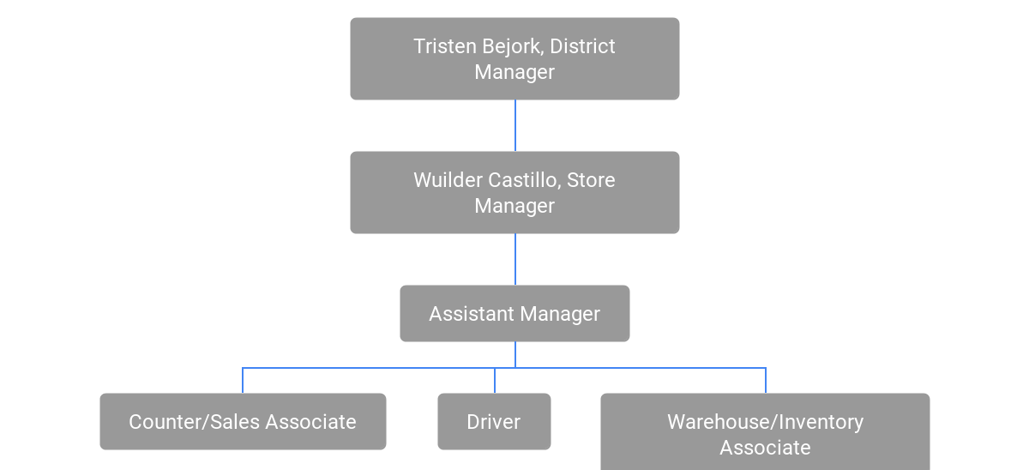
Organization Description (Cont’n)
Organizational Chart of Napa Auto Parts, Vallejo
14 employees at time of data collection due to lay-offs/resignations due to COVID (12 males, 2 females)

Slide 6
Presenting Issue
NAPA Auto Parts is a firm where employees and applicants undergo high levels of voluntary turnover.
This location has a particularly high level of voluntary turnover, and a decreasing number of applicants
The COVID-19 pandemic did not help, caused lay-offs, terminations, or resignations due to health concerns.
Low levels of employee satisfaction due to shortage of employees.

Slide 7
Model
Voluntary Turnover Model by David G. Allen, Phillip C. Bryant, and James M. Vardaman
Focuses on turnover Cause and Effect
Through evidence-based analysis, this model will help us understand:
Different turnover drivers
Alternative opportunities
Attitudes within the firm
Shocks/Scripts
Withdrawal Process

Slide 8
Methods
Primary Data Collection Method:
Asked all employees 10 Focus Group Questions
Secondary Data Collection Method:
Asked all employees 10 Confidential Survey Questions
Alternative Data Collection Method:
Analysis of existing data for turnover rates and # of applicants
All questions were based on measuring employee satisfaction, self-description of skills, and “definition” of company culture

Slide 9
Results
Focus Group Question #6) Without referring to it, are you able to state this firm’s organizational values?
Only 4/14, or approx. 29% of employees described the firm’s org. values as being oriented towards exceptional customer service.
The amount of people describing the firm as oriented towards customer service goes to show that there is probably not a clear goal for the workers that didn’t choose customer service because of the workload they’re receiving and trying to complete it.

Slide 10
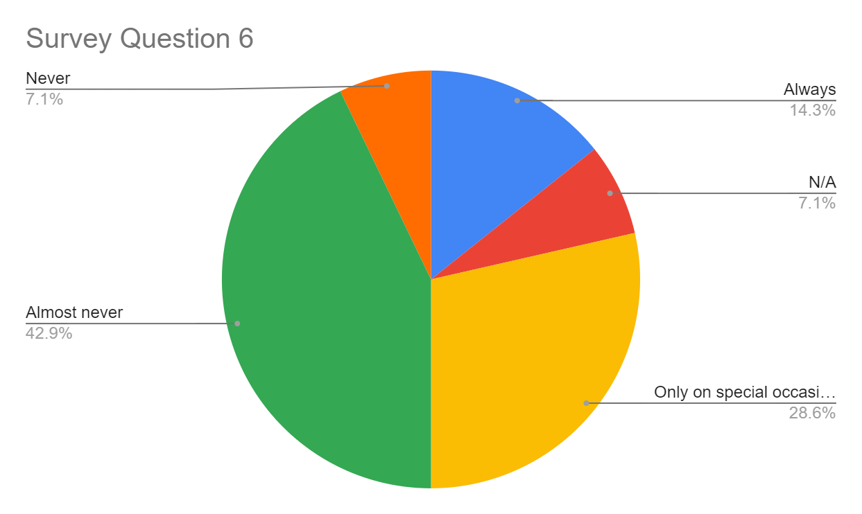
Results
Survey Question #6) How frequently does your manager give you recognition?
About 29% say that recognition occurs only special occasions, and about 43% say it almost never happens, and 7% say that recognition never happens in their case.
Average Score: Almost Never

Slide 11
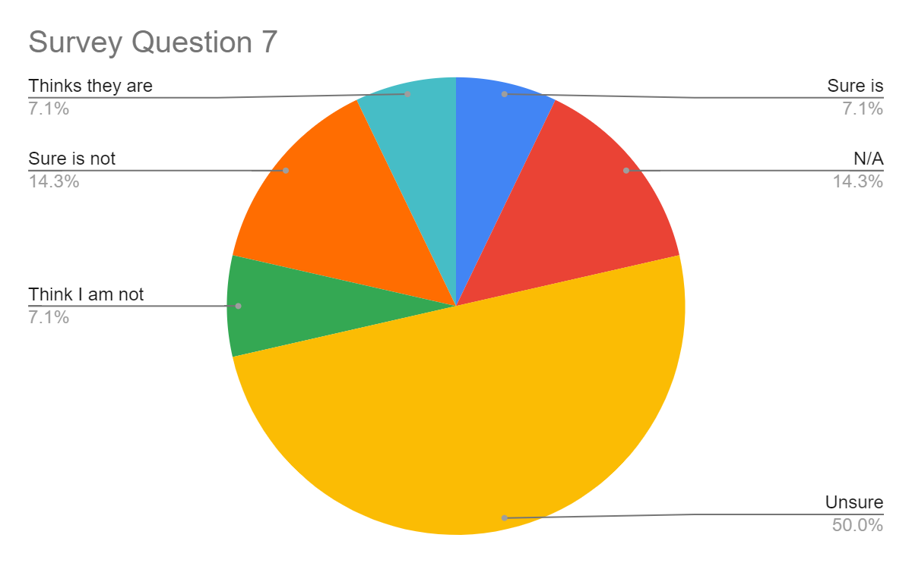
Results
Survey Question #7) To what extent do you believe that you are being paid competitive pay?
About 50% of the employees were unsure if they were about their overall pay-rates, 14% sure they are not getting paid competitively, 7% think they are not,7% are sure they are, and 14% had no response.
Average Score: Unsure

Slide 12
Discussion of Underlying Problems
After thoroughly examining the data garnered from our collection, lack of the following points can be considered underlying issues that are potentially resulting in high turnover rates at Napa, Vallejo:
Strong understanding of company values and vision
Recognition from management
Competitive pay

Slide 13
Recommended Intervention
Based on the underlying issues that were determined from our data collection, we would recommend the following interventions:
The company should invest in cultural activities during which employee efforts are recognized and values are reinstated
Establish Employee of the Month or similar programs, where a single employee recognized during a month is given certain perks
Management should research local competitive pay rates and work to see if those rates can be established at work

Slide 14
Conclusion
-Able to suggest interventions that would aid the cause of lowering the high turnover rate that exists at that firm
-Firm overall seems to be an enjoyable place to work, but factors such as un-competitive pay and lack of recognition from management seem to incline employees to leave the firm.

Slide 15
Thank you!

